Slide 1
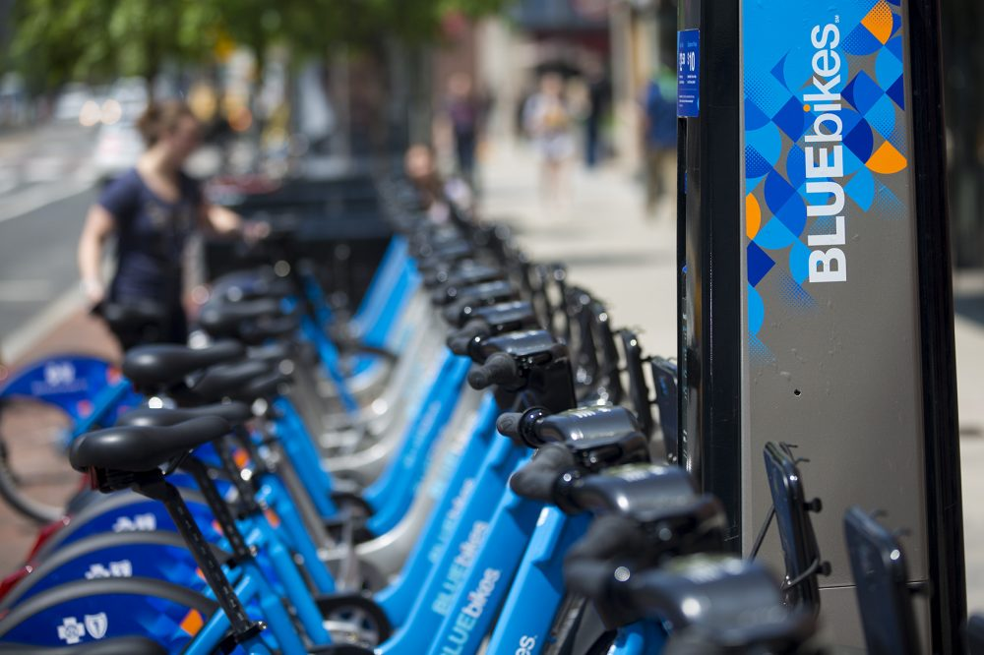
BLUEBIKES
MANAGEMENT
SYSTEM
GROUP 7:-
YASH NEMA- 001562522
MOHIT NAGPAL-001502719
SUSHMITA MAITY-001092534
NIRMAYEE DIGHE-002984202
ARJUN JANARDHAN-001566405
MAHENDRA KASWAN-002195119

Slide 2





OVERVIEW
Serves in Boston
Metropolitan Area
Fleet of 393 Bike Stations & 3800 Bikes
Easily available &
affordable pricing
Higher usage -–> higher inefficiency in ride booking & payments
Proposing a better & efficient RDBMS

Slide 3




PROBLEM STATEMENT
Persistent payment issues & slow loading of the application
Fare calculation w.r.t time duration, membership mode of membership & discount coupons
Providing membership options: Weekly pass, Monthly pass & annual pass
Ensuring data privacy, storage of past records, bike inventory & data accessibility w.r.t roles & requirements.

Slide 4
PROPOSED SOLUTION
Booking management: Setting up account, take a subscription, book a bike, call a customer care, making a payment
Customer Care management: Assign/ Pick tickets from queue
Employee management: Employee details log

Slide 5
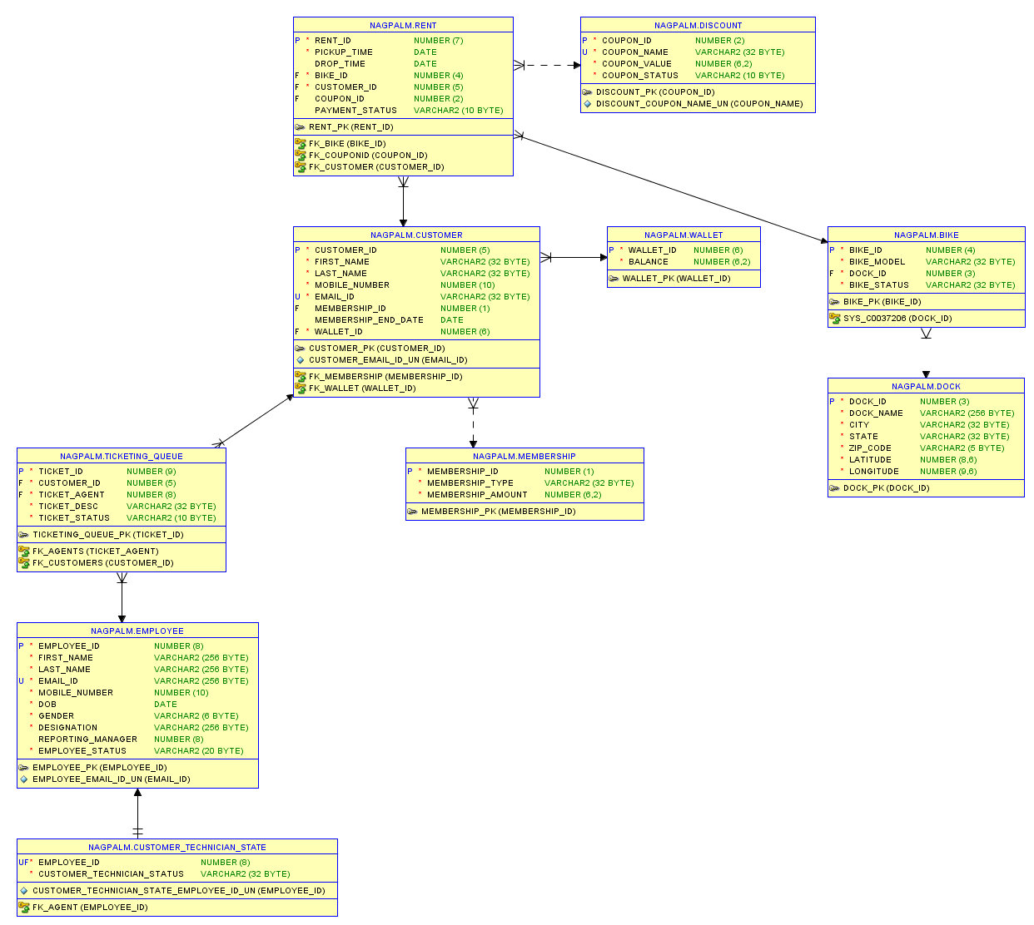
ERD

Slide 6
Key Functions
Tables
Procedures
Packages
Indexes
Triggers
Functions
User roles
Views
Reports

Slide 7
Thank You!

